Slide 1
Course Name: Database Systems Course Code: CS52 Credits: 3:1:0 UNIT 4 Term: Oct 2021 – Feb 2022
M.S. Ramaiah Institute of Technology
(Autonomous Institute, Affiliated to VTU)
Department of Computer Science and Engineering
Faculty:
Dr.Sini Anna Alex

Slide 2
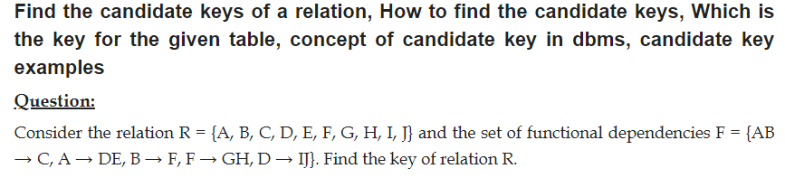
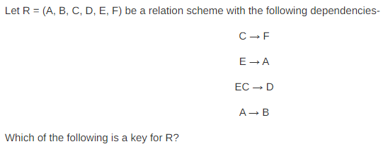

Slide 3
Third Normal Form
Definition:
Transitive functional dependency: a FD X -> Z that can be derived from two FDs X -> Y and Y -> Z
Examples:
SSN -> DMGRSSN is a transitive FD
Since SSN -> DNUMBER and DNUMBER -> DMGRSSN hold
SSN -> ENAME is non-transitive
Since there is no set of attributes X where SSN -> X and X -> ENAME

Slide 4
Third Normal Form
A relation schema R is in third normal form (3NF) if it is in 2NF and no non-prime attribute A in R is transitively dependent on the primary key.
R can be decomposed into 3NF relations via the process of 3NF normalization
NOTE:
In X -> Y and Y -> Z, with X as the primary key, we consider this a problem only if Y is not a candidate key.
When Y is a candidate key, there is no problem with the transitive dependency .
E.g., Consider EMP (SSN, Emp#, Salary ).
Here, SSN -> Emp#, Emp# -> Salary and Emp# is a candidate key.

Slide 5
Normal Forms Defined Informally
1st normal form
All attributes depend on the key
2nd normal form
All attributes depend on the whole key
3rd normal form
All attributes depend on nothing but the key

Slide 6
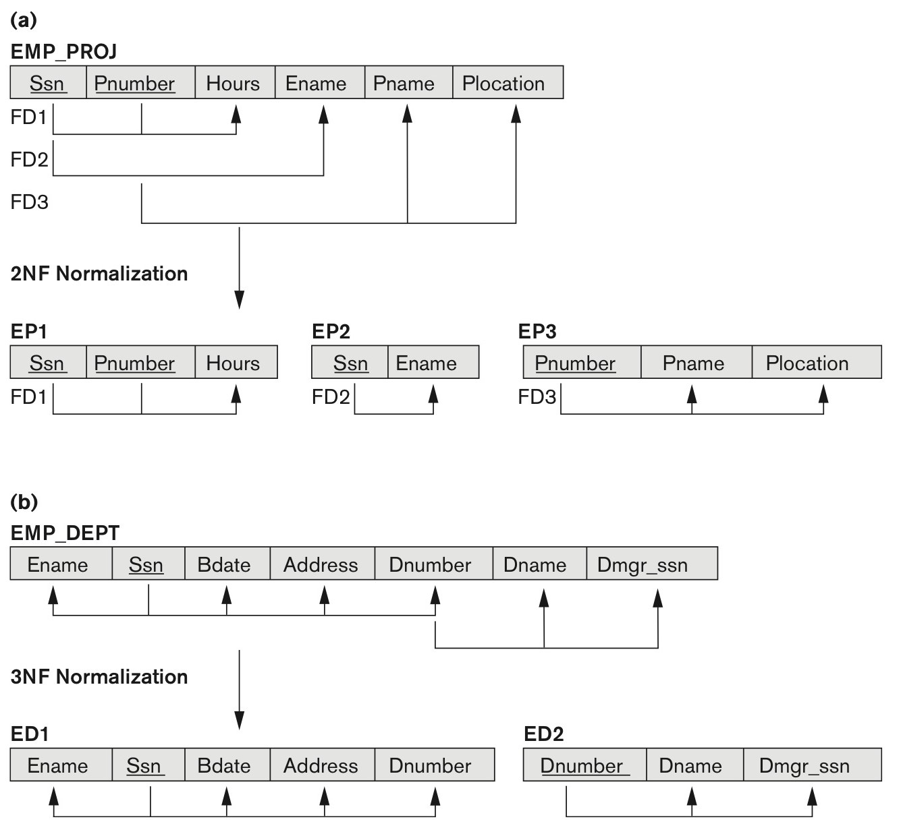
Normalizing into 2NF and 3NF
Normalizing into 2NF and 3NF.
Normalizing EMP_PROJ into 2NF relations.
Normalizing EMP_DEPT into 3NF relations.

Slide 7
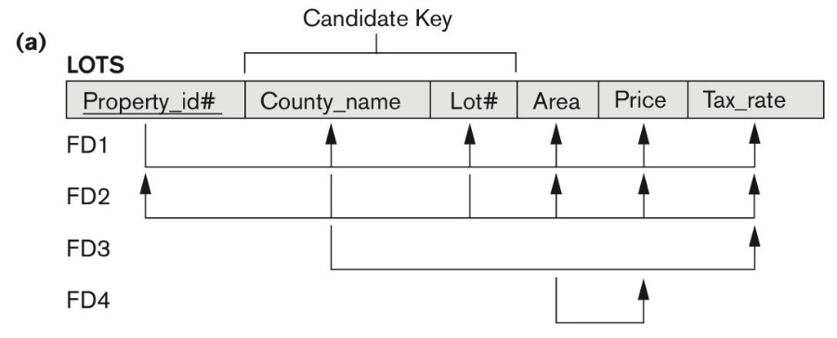
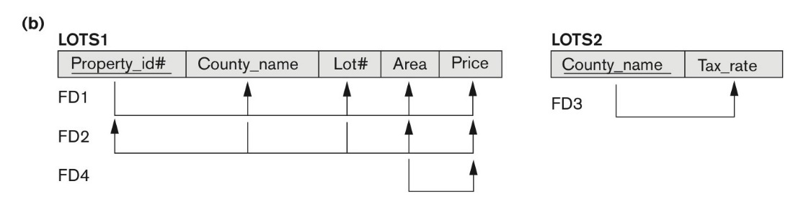
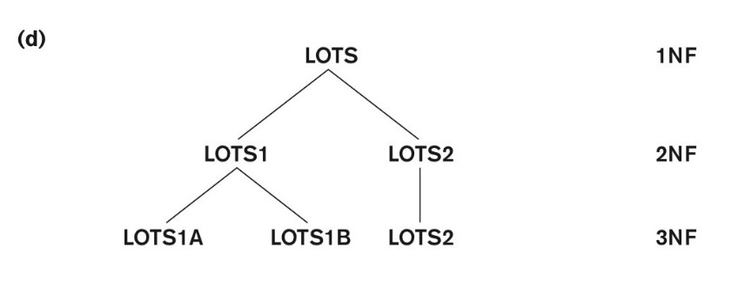
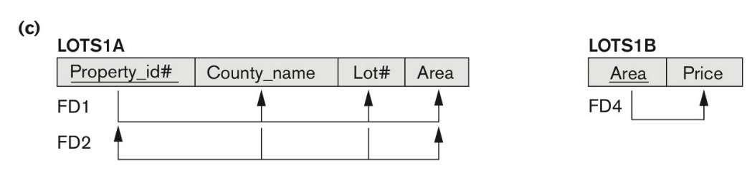
Normalization into 2NF and 3NF
Normalization into 2NF and 3NF.
The LOTS relation with its functional dependencies FD1 through FD4.
(b) Decomposing into the 2NF relations LOTS1 and LOTS2.
(c) Decomposing LOTS1 into the 3NF relations LOTS1A and LOTS1B
(d) Progressive normalization of LOTS into a 3NF design.

Slide 8
General Normal Form Definitions (For Multiple Keys)
The above definitions consider the primary key only
The following more general definitions take into account relations with multiple candidate keys
Any attribute involved in a candidate key is a prime attribute
All other attributes are called non-prime attributes.

Slide 9
General Definition of Third Normal Form
Definition:
Superkey of relation schema R - a set of attributes S of R that contains a key of R
A relation schema R is in third normal form (3NF) if whenever a FD, X → A holds in R, then either:
(a) X is a superkey of R, or
(b) A is a prime attribute of R
LOTS1 relation violates 3NF because
Area → Price ; and Area is not a superkey in LOTS1.

Slide 10
Interpreting the General Definition of Third Normal Form
Consider the 2 conditions in the Definition of 3NF:
A relation schema R is in third normal form (3NF) if whenever a FD X → A holds in R, then either:
(a) X is a superkey of R, or
(b) A is a prime attribute of R
Condition (a) catches two types of violations :
- one where a prime attribute functionally determines a non-prime attribute. This catches 2NF violations due to non-full functional dependencies.
-second, where a non-prime attribute functionally determines a non-prime attribute. This catches 3NF violations due to a transitive dependency.

Slide 11
Interpreting the General Definition of Third Normal Form
ALTERNATIVE DEFINITION of 3NF: We can restate the definition as:
A relation schema R is in third normal form (3NF) if every non-prime attribute in R meets both of these conditions:
It is fully functionally dependent on every key of R
It is non-transitively dependent on every key of R
Note that stated this way, a relation in 3NF also meets the requirements for 2NF.
The condition (b) from the last slide takes care of the dependencies that “slip through” (are allowable to) 3NF but are “caught by” BCNF.

Slide 12
BCNF (Boyce-Codd Normal Form)
A relation schema R is in Boyce-Codd Normal Form (BCNF) if whenever an FD X → A holds in R, then X is a superkey of R
Each normal form is strictly stronger than the previous one
Every 2NF relation is in 1NF
Every 3NF relation is in 2NF
Every BCNF relation is in 3NF
There exist relations that are in 3NF but not in BCNF
Hence BCNF is considered a stronger form of 3NF
The goal is to have each relation in BCNF (or 3NF)

Slide 13
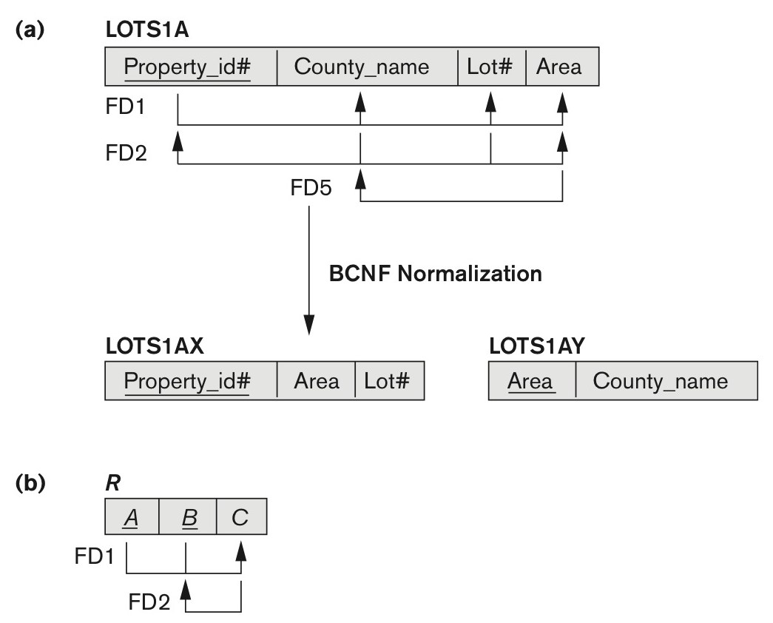
Boyce-Codd normal form
Boyce-Codd normal form.
BCNF normalization of LOTS1A with the functional dependency FD2 being lost in the decomposition.
(b) A schematic relation with FDs; it is in 3NF, but not in BCNF due to the f.d. C → B.

Slide 14
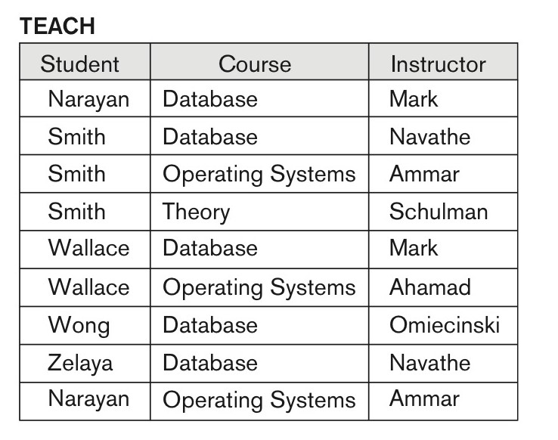
A relation TEACH that is in 3NF but not in BCNF
A relation TEACH that is in 3NF but not BCNF.

Slide 15
Achieving the BCNF by Decomposition
Two FDs exist in the relation TEACH:
fd1: { student, course} -> instructor
fd2: instructor -> course
{student, course} is a candidate key for this .
So this relation is in 3NF but not in BCNF.
A relation NOT in BCNF should be decomposed so as to meet this property, while possibly forgoing the preservation of all functional dependencies in the decomposed relations.

Slide 16

Decompose into 2NF and 3NF relations

Slide 17
Thank you

